Slide 1
Implementing Security Defense: Auditing, Accounting, and Logging
Course Title: Operating Systems
Course Code: CSE-3201
Presented To:
Md.Zahidur Rahman
Lecturer
Department of Computer Science & Engineering
Comilla University
Presented By:
Md.Mehedi Hasan
Session: 2020-21
ID: 12108040
Department of Computer Science & Engineering
Comilla University

Slide 2

Auditing, Accounting, and Logging in System Security
Enhance security by monitoring, tracking, and analyzing activities.
Detect incidents and ensure accountability despite performance trade-offs.

Slide 3

What is Auditing?
Definition
Goals
Systematic review for compliance and security
Identify vulnerabilities
Ensure policy adherence
Detect anomalies
Examples
Vulnerability scans (Nessus, OpenVAS)
Configuration checks (CIS benchmarks)
Compliance audits (GDPR, HIPAA)

Slide 4
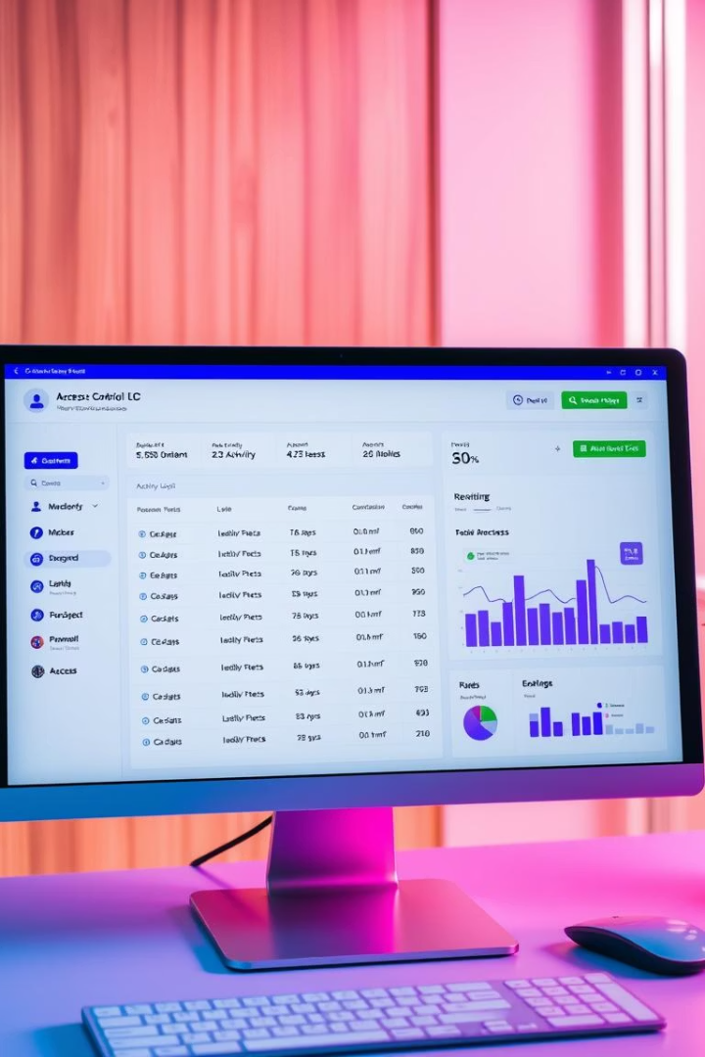

What is Accounting?
Definition
Key Features
Track user and system actions for accountability
Unique user IDs
Role-Based Access Control
Logging critical actions
Security Role
Detect performance changes
Support forensic investigations
Example: UNIX break-in detection

Slide 5
What is Logging?
Definition
Key Events
Record system and user activities for analysis
Failed logins
General: all system calls
Config changes
Specific: suspicious events
Network anomalies
Purpose: detect break-ins, troubleshoot, respond

Slide 6





Benefits of Auditing, Accounting, and Logging
Security
Compliance
Performance
Early detection and forensic evidence
Meet PCI DSS, ISO 27001 requirements
Identify security-related degradation
Accountability
Trace actions to users or processes

Slide 7

Challenges
Performance Impact
Log Overload
False Positives
Log Integrity
Logging slows systems
Too many logs overwhelm analysis
Unnecessary alerts
Risk of tampering
Mitigation: filter low-priority events
Mitigation: fine-tune rules, use AI/ML
Mitigation: cryptographic hashing, secure storage
Mitigation: SIEM tools prioritize

Slide 8






Implementation Best Practices
Centralized Logging
Aggregate logs from all systems
Tools: Elastic Stack, Graylog
Real-Time Monitoring
Alerts for suspicious activities
Tools: Splunk, IBM QRadar
Secure Logs
Encrypt in transit and at rest
Tamper-proof logging
Retention Policy
Keep logs per regulations (1-7 years)
Regular Audits
Periodic and ad-hoc using automated tools

Slide 9



Tools for Auditing, Accounting, and Logging
Auditing
Accounting
Logging
Vulnerability Scanners: Nessus, OpenVAS
IAM: Okta, Azure AD
SIEM: Splunk, Elastic Stack, QRadar
Compliance Tools: AuditBoard, SolarWinds
PAM: CyberArk, BeyondTrust
Log Management: Graylog, Loggly
Network Monitoring: Wireshark, Zeek

Slide 10


Real-World Example
Cliff Stoll’s UNIX Break-In
Detected early UNIX intrusion via accounting logs
Method
Analyzed performance anomalies
Outcome
Traced unauthorized access successfully
Lesson
Accounting and logging uncover hidden threats

Slide 11
Conclusion and Next Steps
Summary
Key Takeaway
Next Steps
Auditing: compliance and vulnerability detection
Essential despite performance trade-offs
Develop security policy
Deploy and integrate tools
Accounting: accountability and anomaly detection
Train staff and test defenses
Logging: visibility into activities

Slide 12

Any queries?

